Slide 1
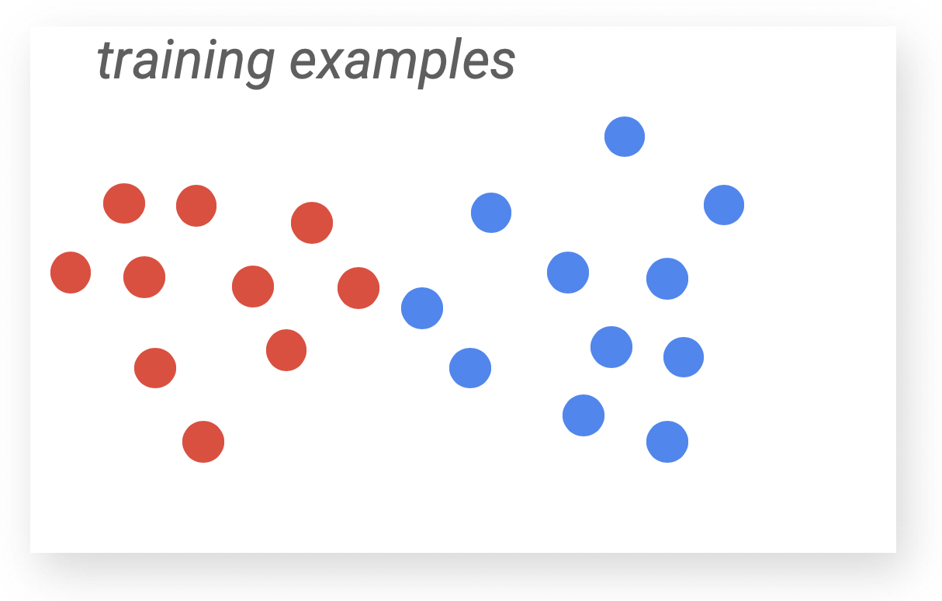
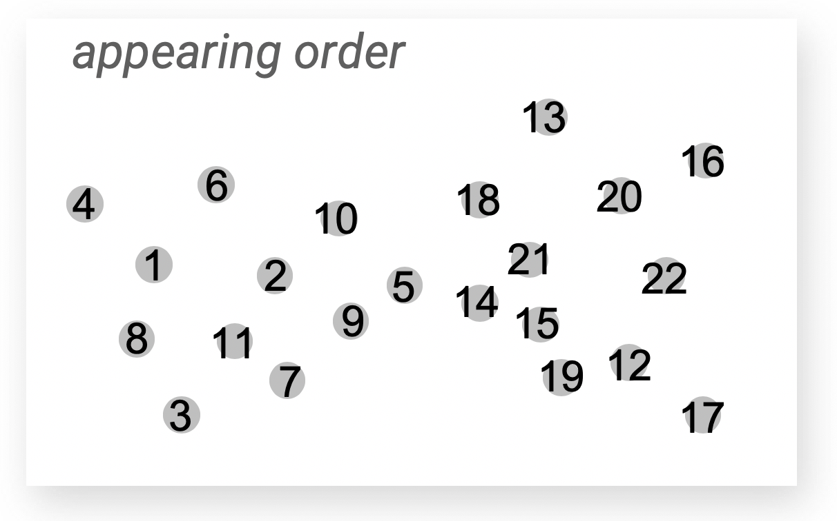
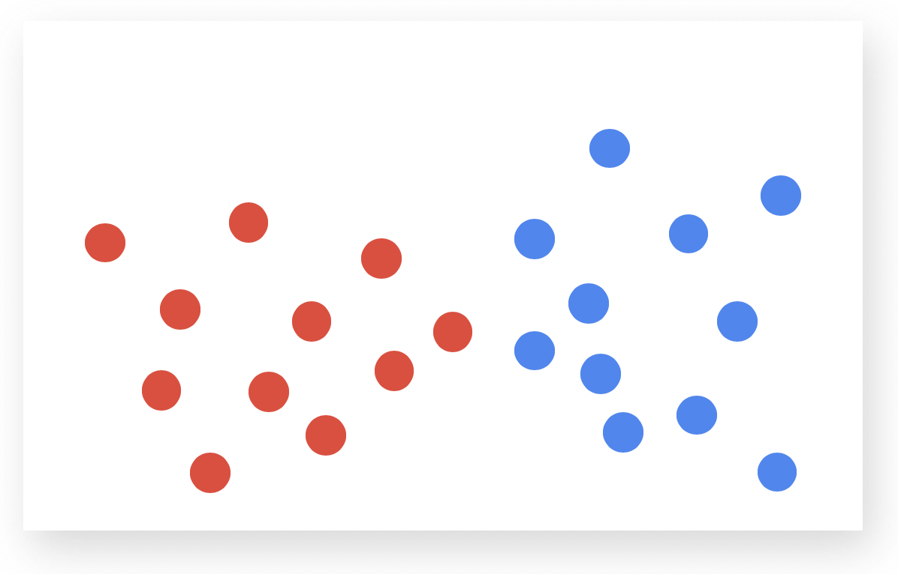
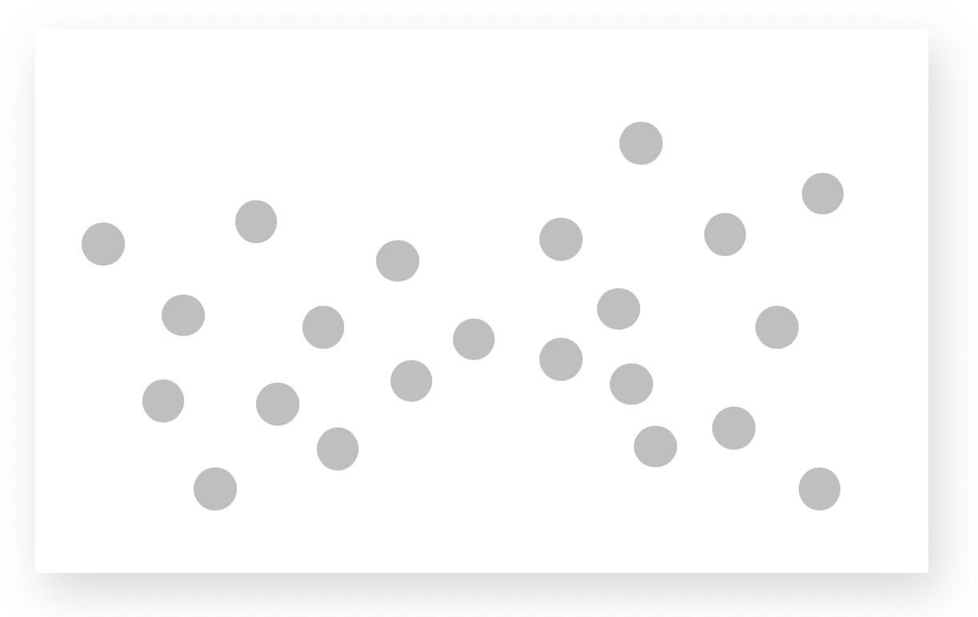
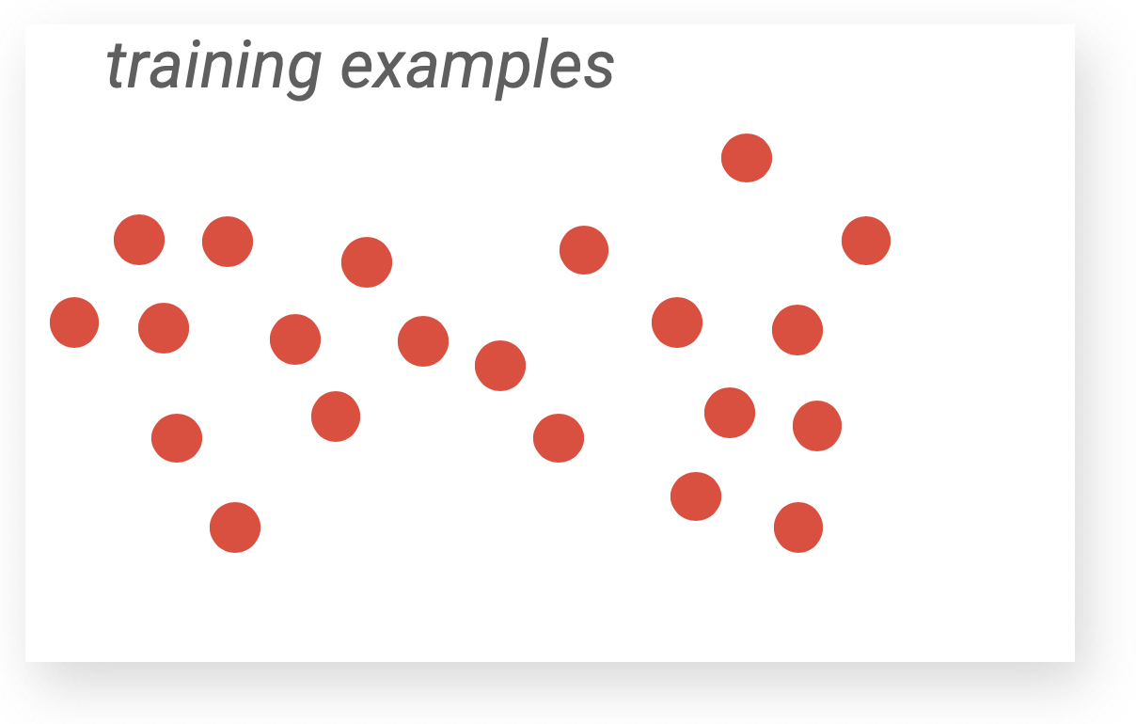
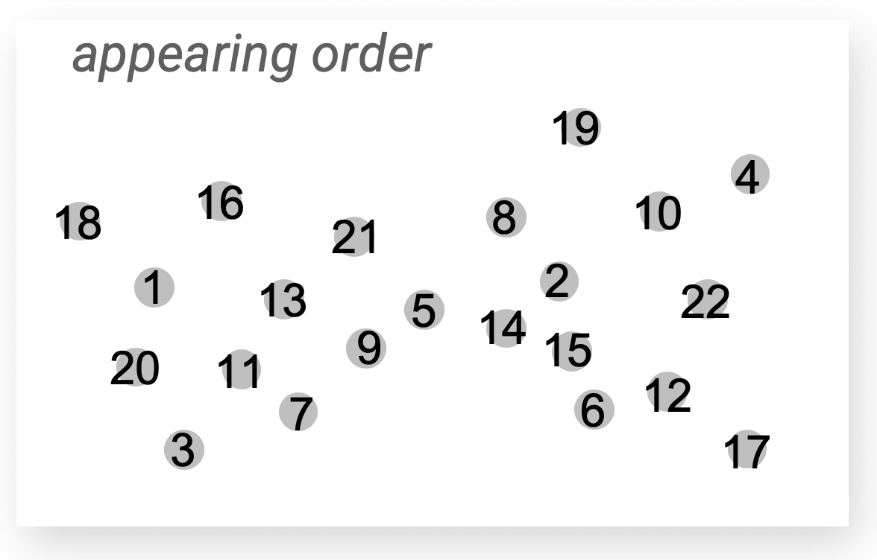
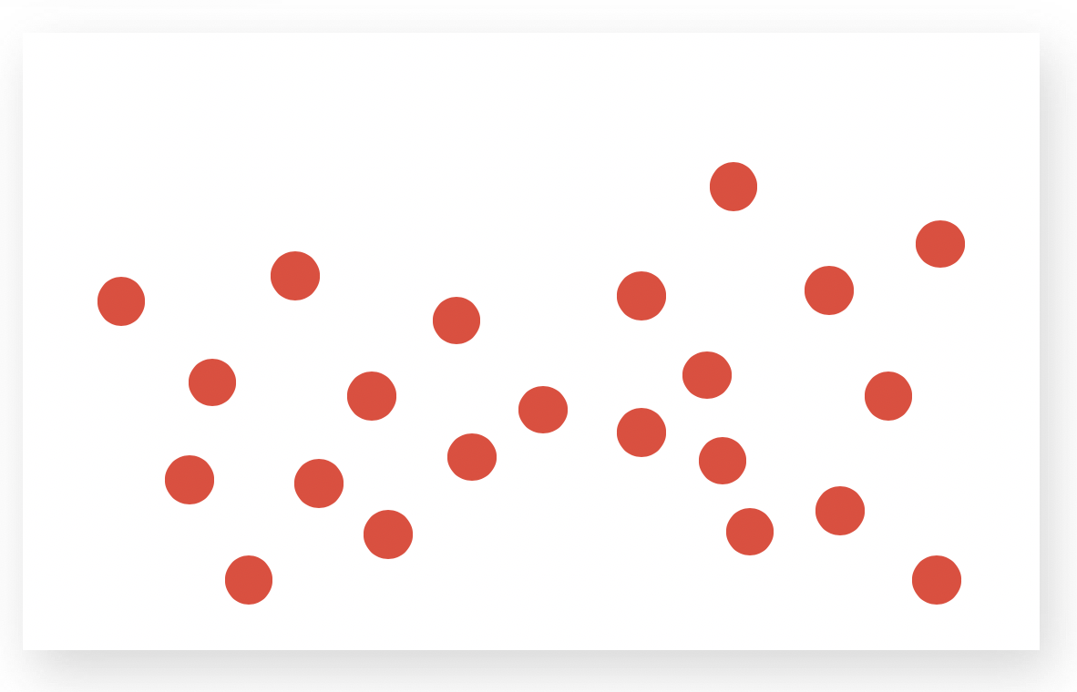
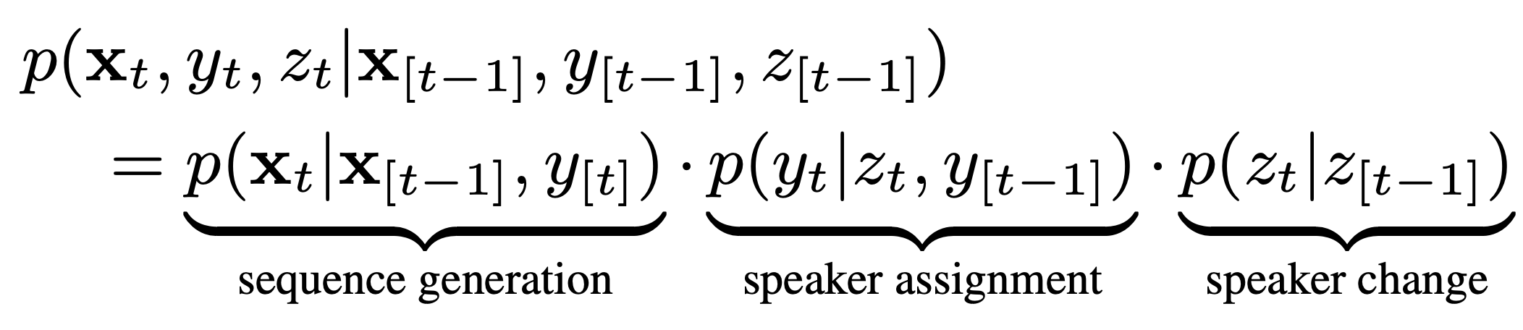
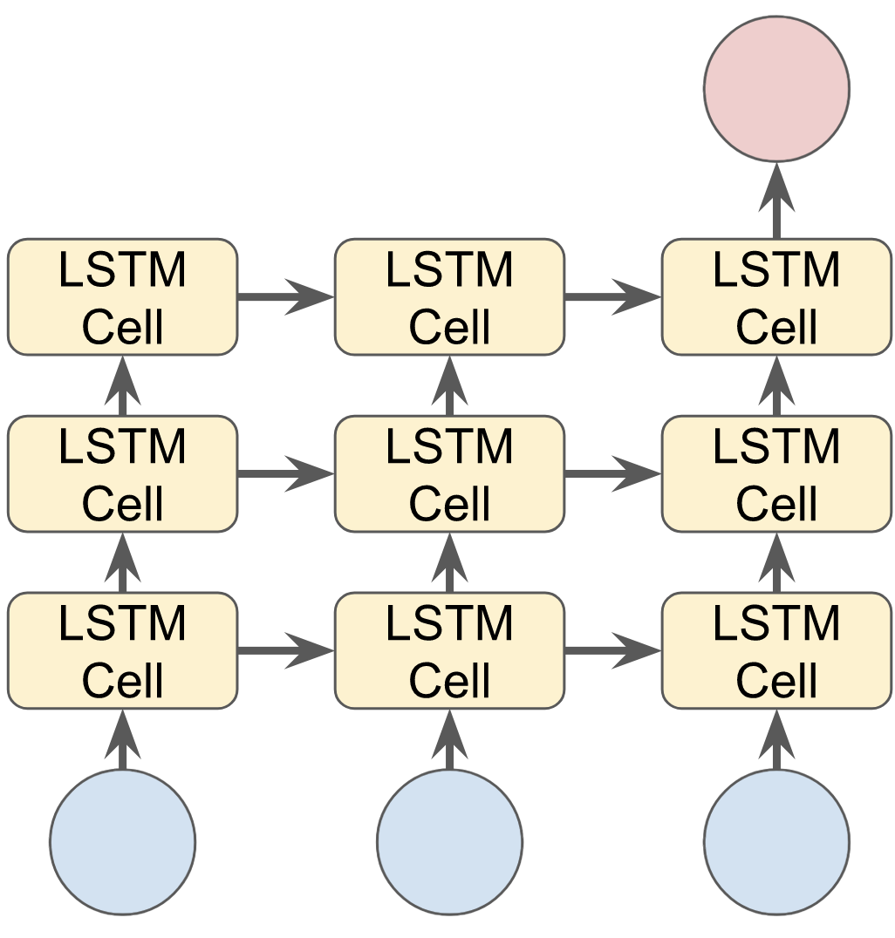
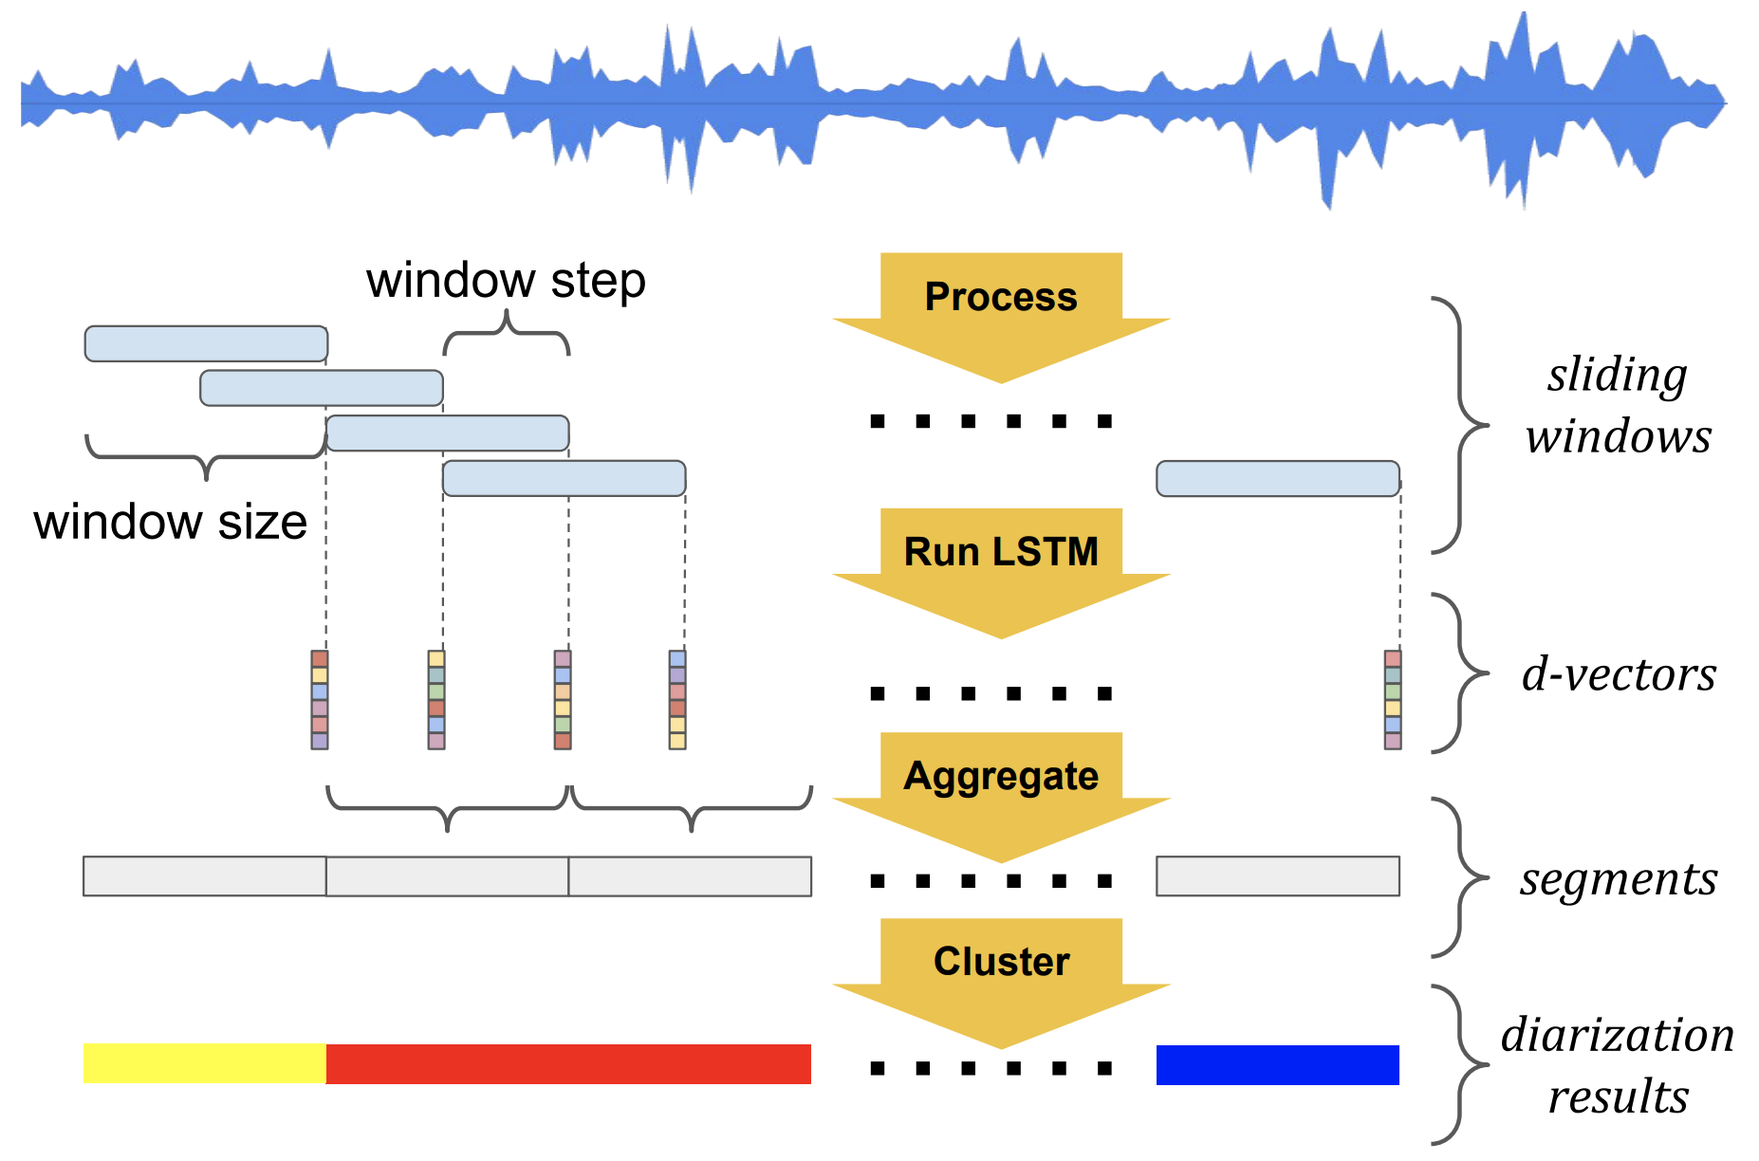
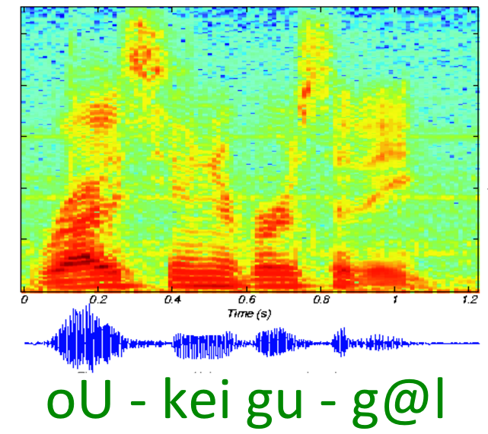
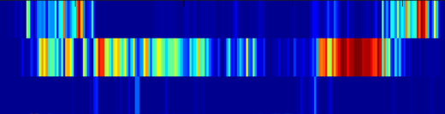

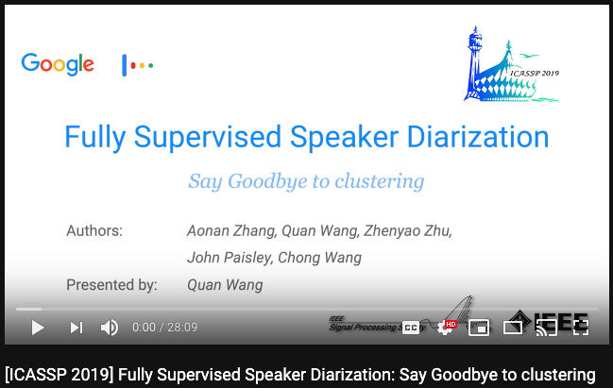
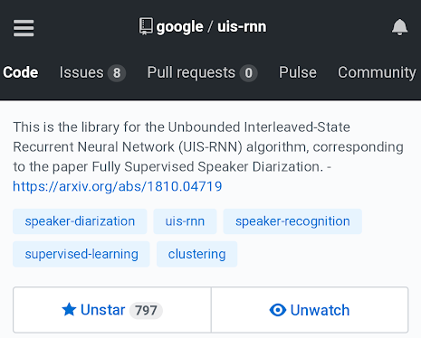
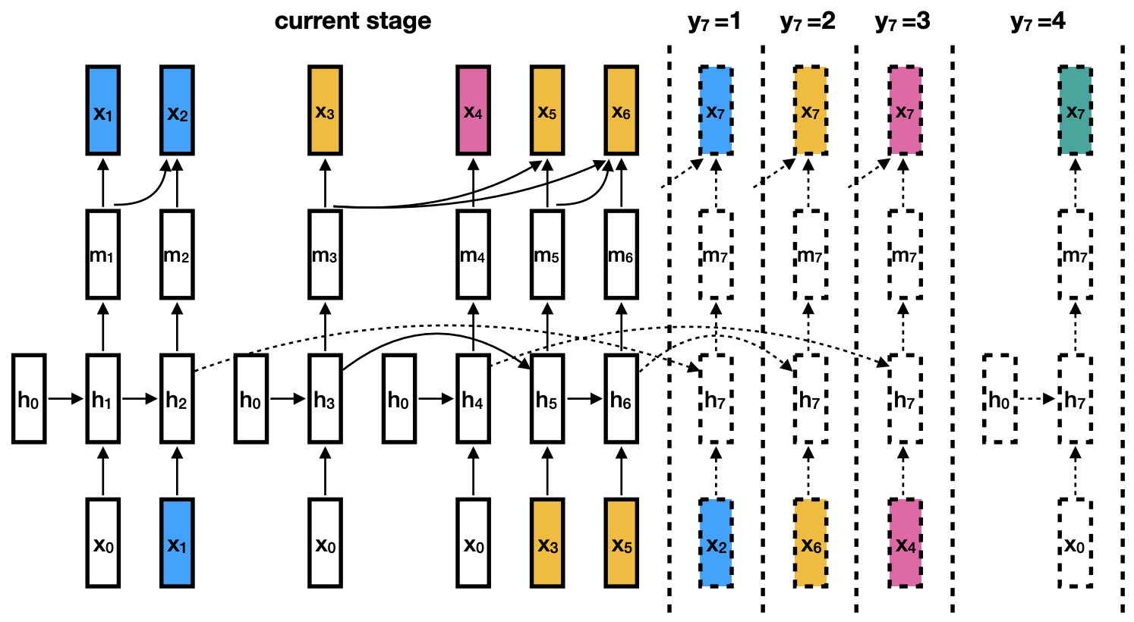
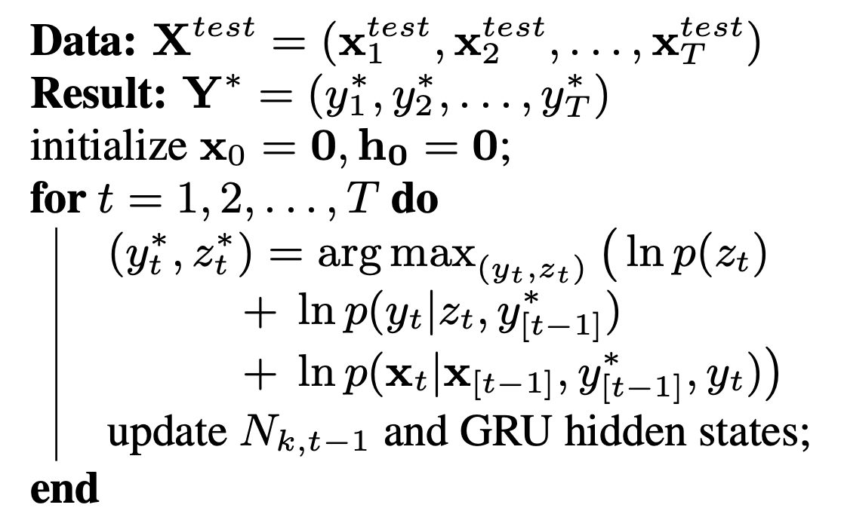

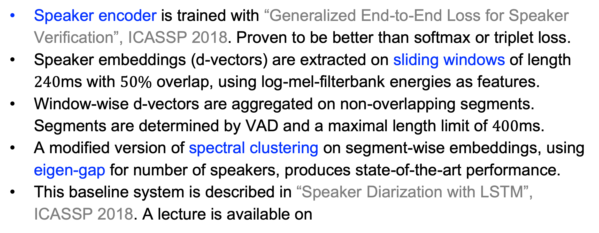
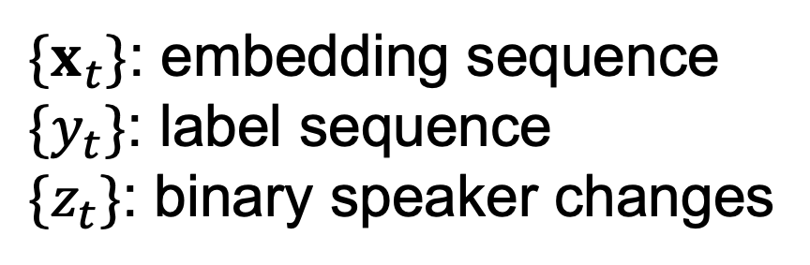
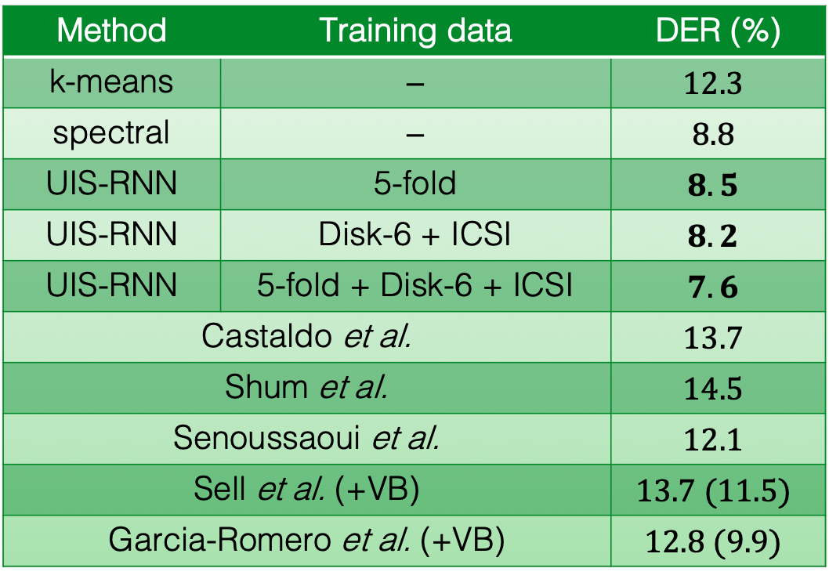
Overview
Clustering is Not Good Enough
Experiment Results
Most existing speaker diarization systems are based on unsupervised clustering approaches, such as k-means or hierarchical clustering.
We propose UIS-RNN, a trainable model for segmenting and clustering temporal data by learning from examples.
New state-of-the-art on CALLHOME, while decoding is online.
How many clusters are there?
2 clusters!
Datasets: NIST SRE 2000 Disk-8 (CALLHOME), Disk-6, and ICSI.
UIS-RNN requires training, so we evaluated with three different setups: in-domain training, off-domain training, and in-domain plus off-domain training.
or
In-domain 5-fold evaluation
Disk-8
×5
Just one!
Fold 1
Fold 2
Fold 3
Fold 4
Fold 5
Speaker 1
1st pass ASR
I would like to sort of buy needle interrupt
Difficult to answer without supervised or temporal information.
or
train
eval
Diarization
Speaker1
Speaker2
Off-domain evaluation
Disk-6
ICSI
Disk-8
I would like to sort of buy needle interrupt
UIS-RNN
train
eval
Speaker 2
2nd pass ASR
on homogeneous
segments
Discouraged by language model in 1st pass
Disk-6
ICSI
Disk-8
×5
I would like to … Sorry but I need to interrupt
We model the generative process of the speaker embedding sequence:
All data 5-fold evaluation
Fold 1
Fold 2
Fold 3
Fold 4
Fold 5
Fig. Speaker diarization solves the problem of “who spoke when”.
Fig. Example application: Improve ASR with diarization results.
$\{x_{t}\}$: embedding sequence
$\{y_{t}\}$: label sequence
$\{z_{t}\}$: binary speaker changes
train
eval
Baseline Diarization System
Table. DER (%) on NIST SRE 2000 Disk-8 (CALLHOME), compared with other teams’ work. VB for Variational Bayesian resegmentation.
Conclusions:
Supervised diarization is helpful, when we have in-domain training data with timestamped speaker labels.
What is learned by UIS-RNN: (1) Dialogue styles; (2) Domain-specific hints for speaker turns.
Future work: (1) Speaker change: coin flipping → RNN; (2) Unlabeled data as part of training set; (3) Offline decoding to further improve quality.
Speaker change
Speaker assignment
Method | Training data | DER (%)
k-means | ⎯ | $$12.3$$
spectral | ⎯ | $$8.8$$
UIS-RNN | 5-fold | $$8.5$$
UIS-RNN | Disk-6 + ICSI | $$8.2$$
UIS-RNN | 5-fold + Disk-6 + ICSI | $$7.6$$
Castaldo et al. |  | $$13.7$$
Shum et al. |  | $$14.5$$
Senoussaoui et al. |  | $$12.1$$
Sell et al. (+VB) |  | $$13.7 (11.5)$$
Garcia-Romero et al. (+VB) |  | $$12.8 (9.9)$$
I.I.D. coin flipping distribution: $p\left(z_{t}=0 | z_{\left[t−1\right]},λ \right)=p_{0}$
Speaker labels are assigned using Chinese restaurant process (CRP)
Table 1
Table 2
Table 3
Table 4
Sequence generation
Fig. Multi-layer LSTM network as speaker encoder.
Fig. Baseline diarization system using d-vectors and unsupervised clustering.
Each speaker is modeled by an RNN instance, all sharing same parameters.
Each instance has its own states. States of different speakers interleave in the time domain.
Each embedding follows a Gaussian, where the mean is this speaker’s average RNN output so far.
More Information
Speaker encoder is trained with “Generalized End-to-End Loss for Speaker Verification”, ICASSP 2018. Proven to be better than softmax or triplet loss.
Speaker embeddings (d-vectors) are extracted on sliding windows of length $240$ms with $50\%$ overlap, using log-mel-filterbank energies as features.
Window-wise d-vectors are aggregated on non-overlapping segments. Segments are determined by VAD and a maximal length limit of $400$ms.
A modified version of spectral clustering on segment-wise embeddings, using eigen-gap for number of speakers, produces state-of-the-art performance.
This baseline system is described in “Speaker Diarization with LSTM”, ICASSP 2018. A lecture is available on
Full lecture is available on
Core algorithm on __________
https://github.com/google/uis-rnn
Fig (Left). Four possible generative paths in an example sequence.
Fig (Right). Online greedy MAP decoding algorithm.

